Slide 1
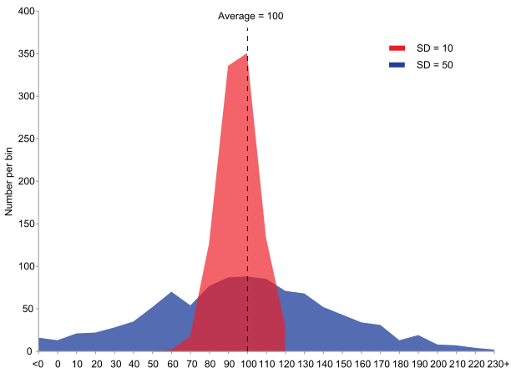
Standard deviation, skew, and variance
Geog4300/6300
Jerry Shannon

Slide 2
Central tendency doesn’t tell us everything…
Notes:
How are these different?

Slide 3
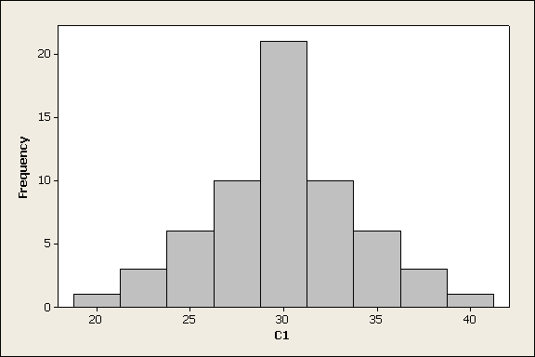
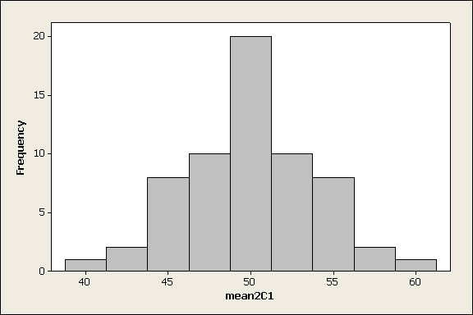
How do these compare?
Notes:
How are these different?

Slide 4
How do these compare?
Notes:
How are these different?

Slide 5
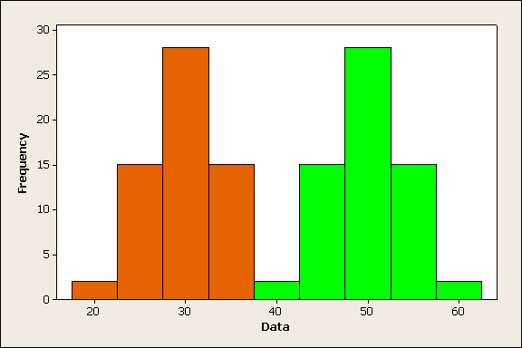
Notes:
Same distribution, differing means. Together would be a bi-modal distribution.

Slide 6
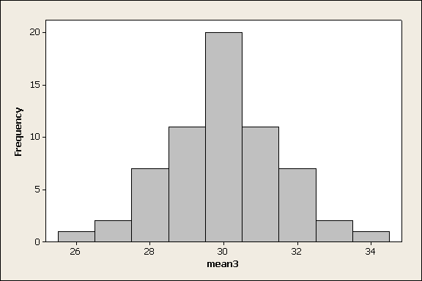
Now, how do these compare?
Notes:
Difference in spread--variation

Slide 7
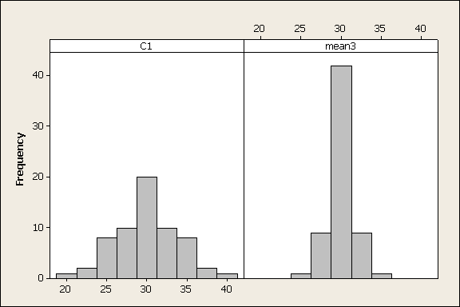
Using a similar range for x

Slide 8
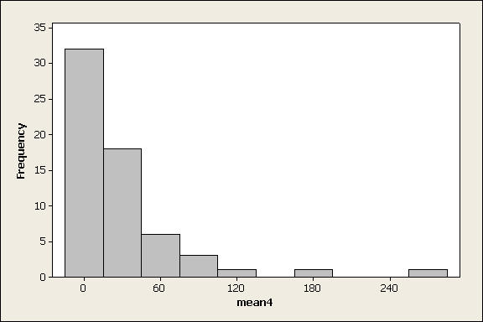
Differences in symmetry

Slide 9
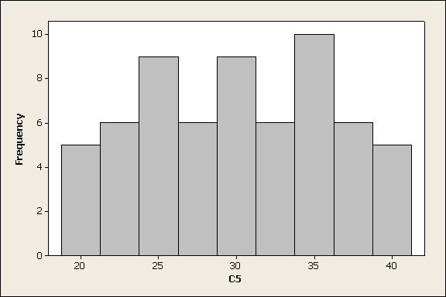
Differences in shape

Slide 10
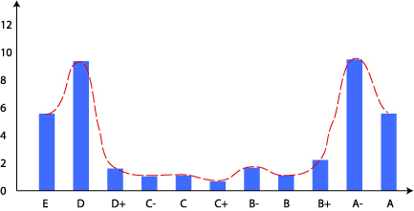
How many kinds of distributions are there??
Bi-modal
mode 1
mode 2
mean
median

Slide 11
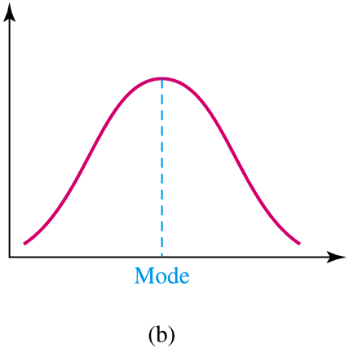
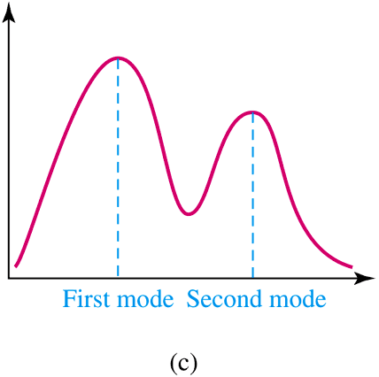
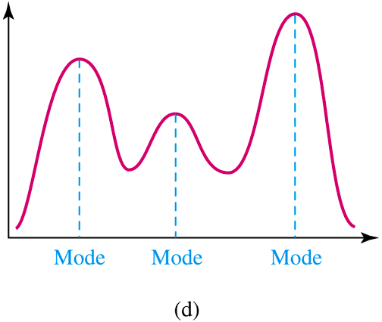
Many kinds of multimodal distributions

Slide 12
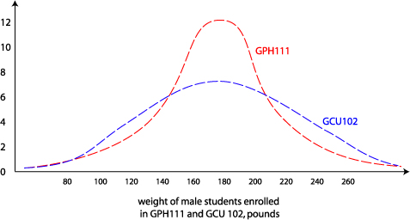
Shape of the dispersion
Not all normal distributions are created equal.

Slide 13
Dispersion
Two poker hands:
Full house: 4, 4, 4, 6, 6
Pair of eights: 2, 4, 8, 8, Q
Which has the greater dispersion?
How could we measure this?

Slide 14
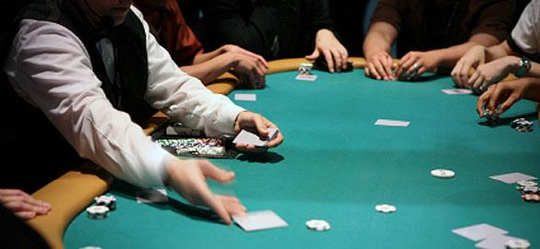
Could take the range
High value – low value
Full house: 6 -4= 2
Pair of 8s: Q (12) – 2 = 10

Slide 15
Could take the range
[High value] – [low value]
Full house: 6 -4= 2
Pair of 8s: Q (12) – 2 = 10
BUT…
large samples have greater ranges than small samples
this only measures two observations (ignoring many more)

Slide 16
How about the mean deviation?
Draw a five card poker hand from your deck. Find the mean.
Subtract the mean value from each of your cards (find the deviation)
Add up these deviations. Explain what you find.
Example:
A hand of 2, 5, 8, 8, and Q (12)
Mean value of (35/5) = 7
2 – 7 = -5, 5 - 7 = -2,…
Add -6 + -2 + …

Slide 17
How about the mean deviation?
A solution:
sum the absolute value of those deviations
then divide by n
Deviations
2 – 7= -5
5 – 7= -2
8 – 7= 1
8 – 7= 1
12 – 7= 5
Mean deviation
(5 + 2 + 1 + 1 + 5) / 5 = 2.8

Slide 18
The standard deviation
Fact: absolute values are hard to deal with algebraically. How else can we get all those deviations positive?
the standard deviation is the square root of the mean squared deviations…

Slide 19
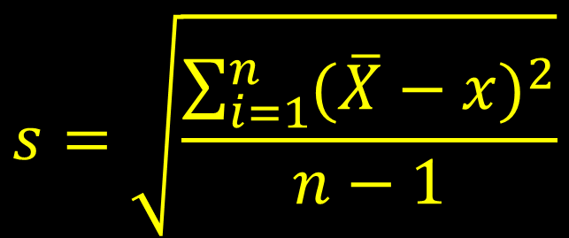
The standard deviation
Full house: 4, 4, 4, 6, 6
Mean: 4.8
Differences from mean:
-.8, -.8, -.8, 1.2, 1.2
$$s=\sqrt{\frac{\sum_{i=1}^{n}{{(\overline{X}−x)}^{2}}}{n−1}}$$
Square of differences:
.64, .64, .64, 1.44, 1.44
Sum of squares: 4.8
Sum divided by n-1 (4): 1.2
Square root (s.d.): 1.1

Slide 20
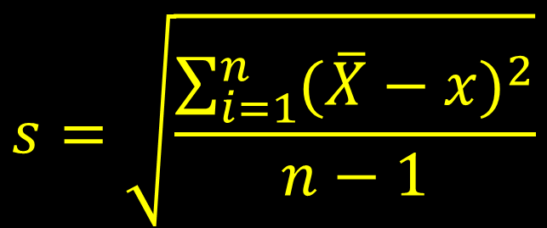
The standard deviation
Pair of eights: 2, 5, 8, 8, 12
Mean: 7
$$s=\sqrt{\frac{\sum_{i=1}^{n}{{(\overline{X}−x)}^{2}}}{n−1}}$$
Differences from mean:
-5, -2, 1, 1, 5
Square of differences:
25, 4, 1, 1, 25
Sum of squares: 56
Sum divided by n-1 (4): 14
S.D. of full house: 1.1
Square root (s.d.): 3.7

Slide 21
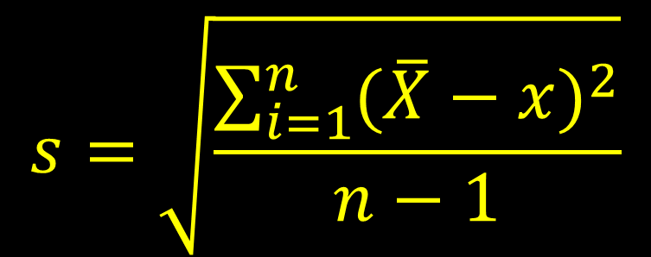
The standard deviation
Draw a hand from your poker deck
Calculate its standard deviation
$$s=\sqrt{\frac{\sum_{i=1}^{n}{{(\overline{X}−x)}^{2}}}{n−1}}$$
Statistical aside: the variance is the square of the standard deviation. It’s sometimes used in inferential statistics.

Slide 22
In R
Use the “sd” function
Draw 5 poker hands and enter each into r.
Hand1<-c(2, 5, 6, 2, 6)
Hand2<-c(5, 12, 7, 1, 9)
...
What are the mean and standard deviations?
Relevant functions are mean() and sd()

Slide 23
The standard deviation
Varies based on sample size:
ACT scores (10-36): sd of 5.2
SAT scores (900-2400): sd of 116
How can we compare them?

Slide 24
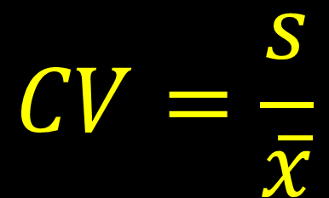
The coefficient of variation
Used to compare the spread of data sets with different means
ACT 2010
Average score: 21, SD: 5.2
$$CV=\frac{s}{\overline{x}}$$
SAT (Math) 2010
Average score: 516, SD: 116
Coefficient of Variation
ACT: .25, SAT: .23

Slide 25
The coefficient of variation
Used to compare the spread of data sets with different means
ACT 2010
Average score: 21, SD: 5.2
$$CV=\frac{s}{\overline{x}}$$
SAT (Math) 2010
Average score: 516, SD: 116
Coefficient of Variation
ACT: .25, SAT: .23

Slide 26
You try it!
Use CV to compare the standard deviations for the raw number of people classified as white and the percentage.
Use Excel: calculate the mean (=average) and standard deviation (=stdev) and then create the cv.

Slide 27
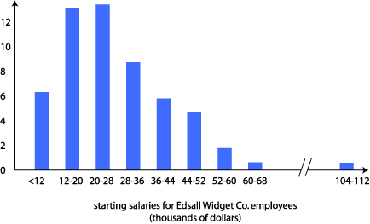
Skewed: Median ≠ mean
Positively skewed: median < mean
mode
mean
mode 1
median
mode 2
mean
median

Slide 28
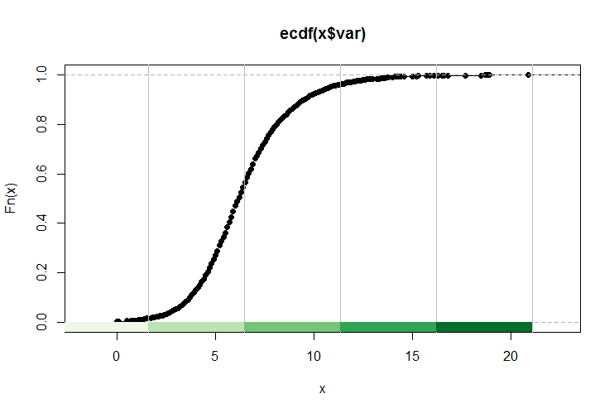
Skewed: Median ≠ mean
Positively skewed: median < mean

Slide 29
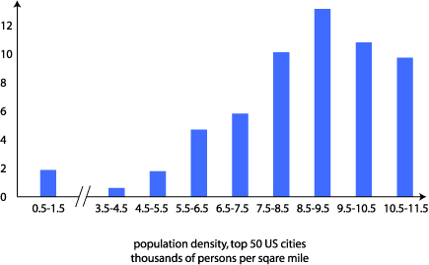
Negatively skewed: median > mean
mode
mean
median

Slide 30
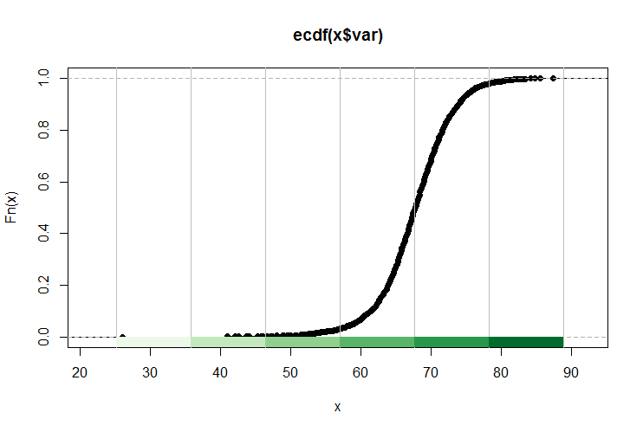
Negatively skewed: median > mean

Slide 31
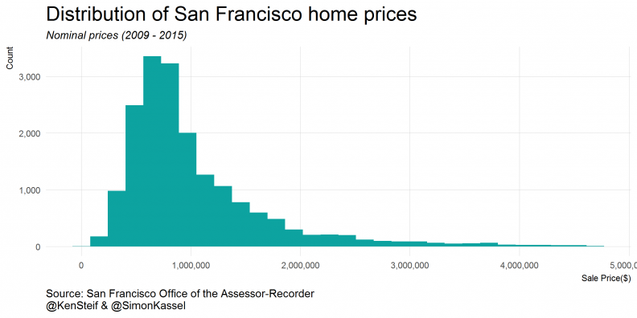
Normal, negatively skewed, or positively skewed?
Home values in San Francisco
http://urbanspatialanalysis.com/dataviz-tutorial-mapping-san-francisco-home-prices-using-r/

Slide 32
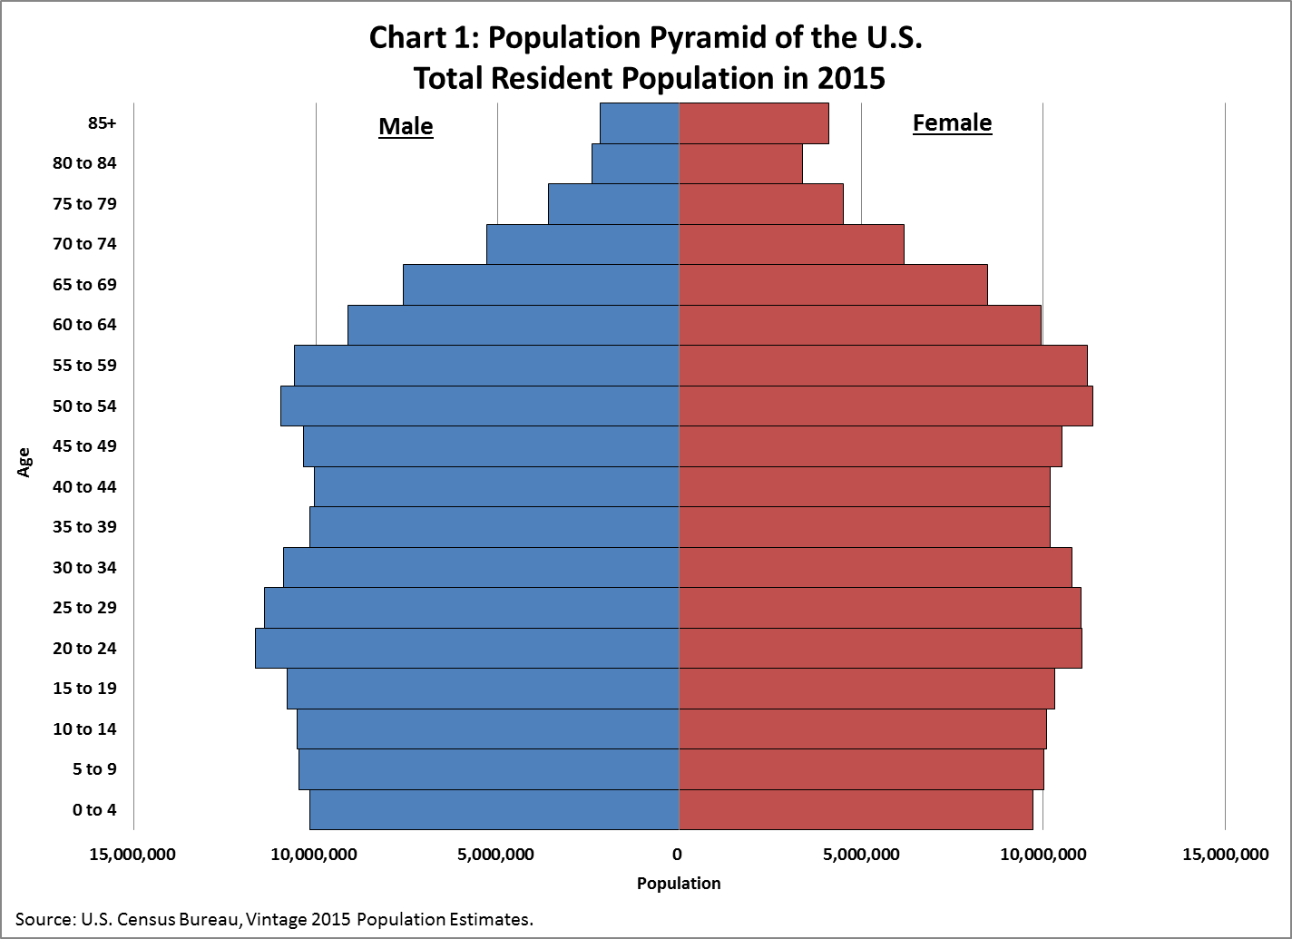
Normal, negatively skewed, or positively skewed?
Population distribution by age in the U.S.
https://www.census.gov/newsroom/blogs/random-samplings/2016/06/americas-age-profile-told-through-population-pyramids.html

Slide 33
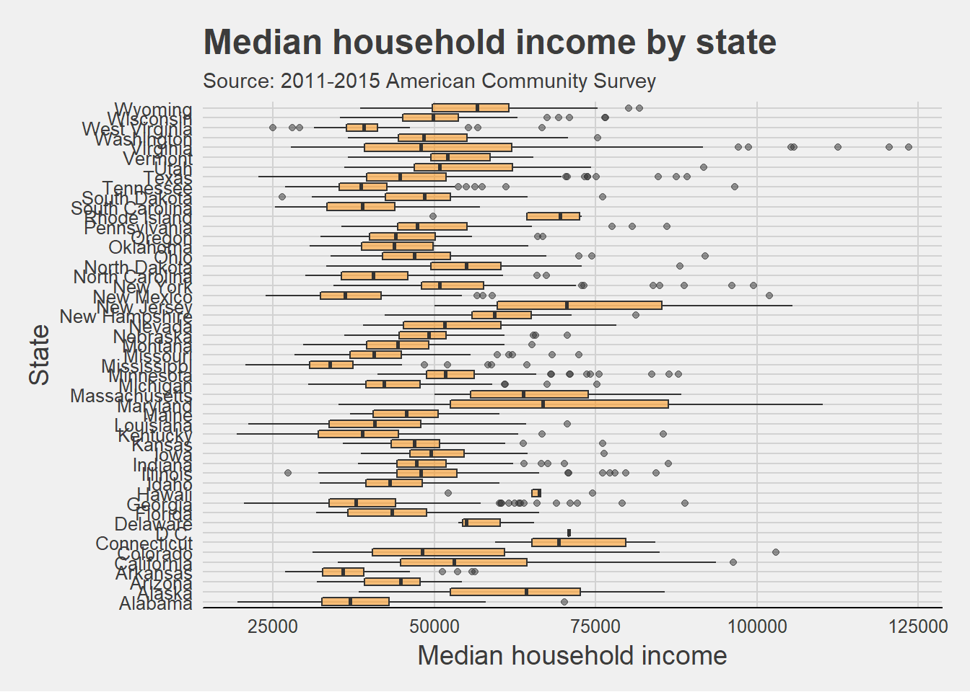
Normal, negatively skewed, or positively skewed?
Median household income
https://rpubs.com/Oleksiy/usmedianhouseholdincome

Slide 34
Normal, negatively skewed, or positively skewed?
Median household income
https://rpubs.com/Oleksiy/usmedianhouseholdincome

Slide 35
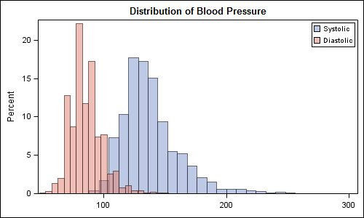
Normal, negatively skewed, or positively skewed?
Blood pressure
https://blogs.sas.com/content/graphicallyspeaking/2012/02/06/comparative-densities/

Slide 36
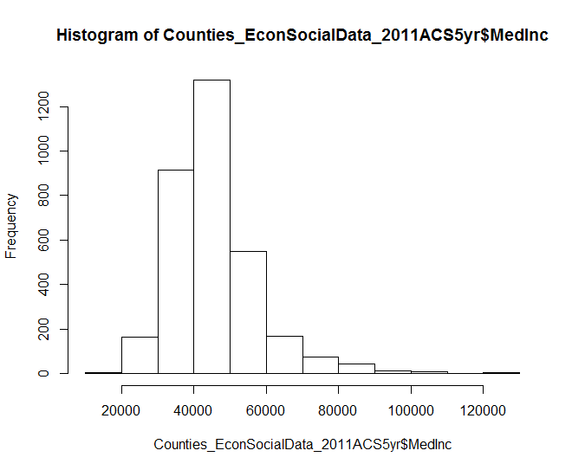
Skewness can be measured!
Pearson’s skewness
3(X – Median)
s
Median household income (county mean): $45,473
Median household income (county median): $43,601
SD: 11,953
3
(3 x (45,473 – 43,601)) / 11,953 = .47

Slide 37
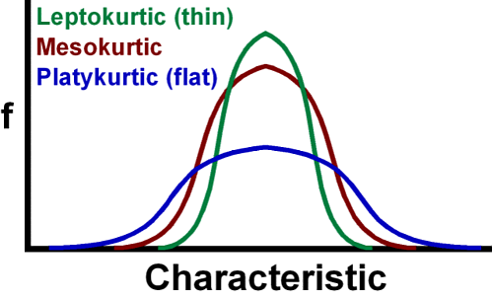
Kurtosis
How flat a distribution is
bogleheads.org

